Slide 1

Projects In Laravel
What Is Laravel?

Slide 2
What Is Laravel?
Open source PHP web framework
Uses the MVC design pattern
Most popular PHP framework
Used to build database-driven dynamic websites and applications

Slide 3
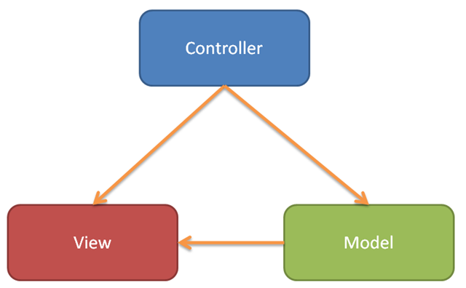
MVC Concepts
Model – Data interaction & data-related logic
View – User interface
Controller – Takes requests and is the interface between model and view

Slide 4
Installing With Composer
Composer is a PHP package manager
Used to install Laravel and create an app
$ composer global require "laravel/installer“ $ Laravel new appname
OR
$ composer create-project laravel/laravel appname

Slide 5
Artisan CLI
Laravel’s command Line Interface
Make controllers, models, migrations
Run migration files
Tinker REPL – Interact with app/database from cli

Slide 6
Artisan CLI Command Examples
$ php artisan list
$ php artisan help migrate
$ php artisan make:controller PostsController
$ php artisan make:model Post –m
$ php artisan make:migration add_posts_to_db –table=posts
$ php artisan migrate
$ php artisan tinker

Slide 7
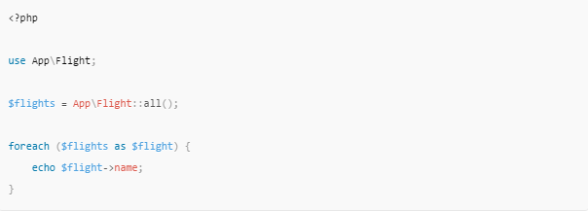
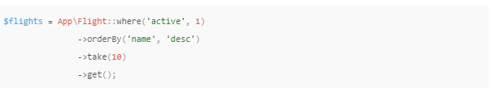
Eloquent ORM
Object Relational Mapper / ActiveRecord Implementation

Slide 8
Blade Templating
Simple but powerful template engine
Does not restrict php in views
Compiled into plain php and cached / No overhead
Views can extend layouts

Slide 9
<html>
<head>
<title>App Name - @yield('title')</title>
</head>
<body>
<div class="container">
@yield('content')
</div>
</body>
</html>

Slide 10
@extends('layouts.app')
@section('title', 'Page Title')
@section('content')
<p>This is my body content.</p>
@endsection

Slide 11


